Slide 1
Central Kentucky Caucus
& Regional Policy Group
Midway University
January 27, 2025
Notes:
Bob – Intro
Thank Midway University for hosting the and for being a Policy Partner.
Welcome state legislators, local officials and Regional Policy Leaders.
All of you are important stakeholders in our efforts to make this region more competitive for jobs and people.
We are better together.
Intro Dr. Marsden for welcome remarks.

Slide 2
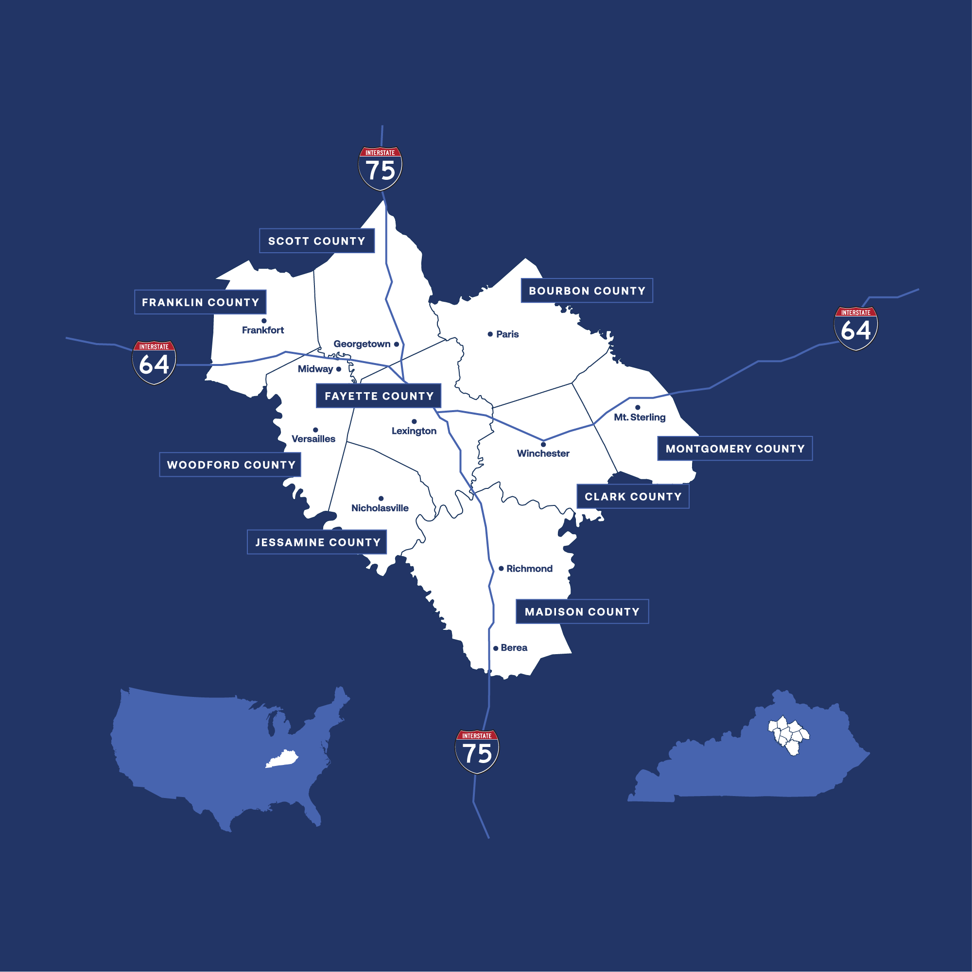
Regional Competitiveness Plan
Notes:
Thank you for the opportunity to share about the Regional Competitiveness Plan.
The Regional Plan is aimed at making this region more competitive for jobs and talent.

Slide 3
History &
Context
For many years, Commerce Lexington has partnered with leaders in the region on collaborative efforts and programs.
Job Recruitment
Public Policy
Leadership Development
Notes:
Regionalism is not a new concept.
The seeds of regionalism were planted more than 30 years ago when major employer located in the region (Toyota in Georgetown).
Since that time, business, government and education leaders have informally worked together across economic development and public policy.
The economic development professionals collaborate to market a larger geographic area to businesses and site selectors.
To compete with larger metros, we are better together! (workforce, job sites, housing, quality of Life, education, UK)
Regional leaders have also supported each other on public policy efforts to advocate for policies or projects with positive impacts regionally.

Slide 4
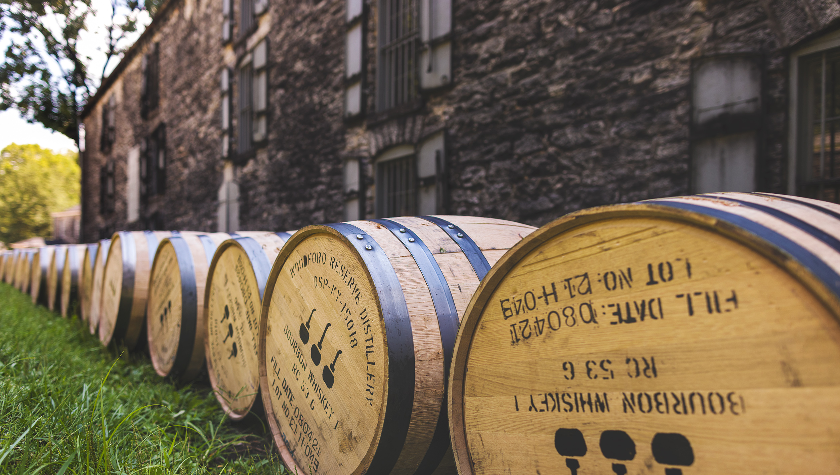
Place-Based Competitiveness
Business Climate
​Taxes
Regulatory Climate
Legal Climate
Politicians​
Infrastructure
Water
Transportation
Broadband
Power
Housing
Childcare
Workforce​
​In-migration
Education
Productivity
Costs
Skills
QOL
Innovation
​R&D
Automation
Patents
Advanced Industries
Start-up Ecosystem
Risk
​Weather
Crime
Fiscal Stability
Political Stability
Out-migration
Geo-economics
Notes:
What is competitiveness?
- Business, site selectors and talent are reviewing data points about competitiveness across 5 categories.

Slide 5
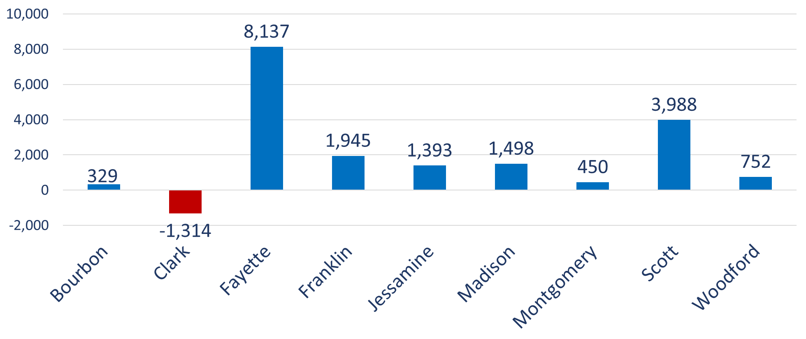
Greater LEX Regional Job Growth 2018-2023

Slide 6
Greater LEX Region Labor Force Growth 2018-2023

Slide 7
MSA | Momentum Index | Cost & Business Climate Index | Future Index | Talent Index | Quality of Place | Total Score | Overall Rank
Nashville, TN | 1 | 1T | 1 | 1 | 1 | 5 | 1
Knoxville, TN | 3 | 1T | 3 | 3T | 5T | 15 | 2
Indianapolis, IN | 2 | 4T | 2 | 6 | 8T | 22 | 3
Cincinnati, OH | 5 | 8 | 5T | 5 | 3T | 26 | 4
Columbus, OH | 7 | 9T | 7 | 2 | 3T | 28 | 5
Richmond, VA | 4 | 7 | 8 | 3T | 8T | 30 | 6
Greenville, SC | 6 | 9T | 4 | 7T | 5T | 31 | 7
Lexington, KY | 11T | 6 | 9 | 7T | 2 | 35 | 8
Louisville, KY | 9 | 3 | 5T | 9 | 10T | 36 | 9
Greensboro, NC | 10 | 4T | 10 | 11T | 7 | 42 | 10
Virginia Beach, VA | 8 | 9T | 12 | 11T | 10T | 50 | 11
St. Louis, MO | 11T | 13 | 11 | 10 | 12T | 57 | 12
Huntington, WV | 13 | 12 | 13 | 13 | 12T | 63 | 13
Competitor Metros
Notes:
We also looked at how we ranked against some of our competitors cities or cities of a similar size based on competitiveness indexes.
Our key takeaways:
We have a quality of life strengths that needs to be leveraged.
We have a momentum challenge.
What is the momentum index? - It refers to the “projected growth” of the region.
Our growth in wages, GDP, AND workforce were slowing and were below the national average.
We were also not increasing young professionals – which was surprising given we have 10 colleges and universities in the region. 20k graduates per year.

Slide 8
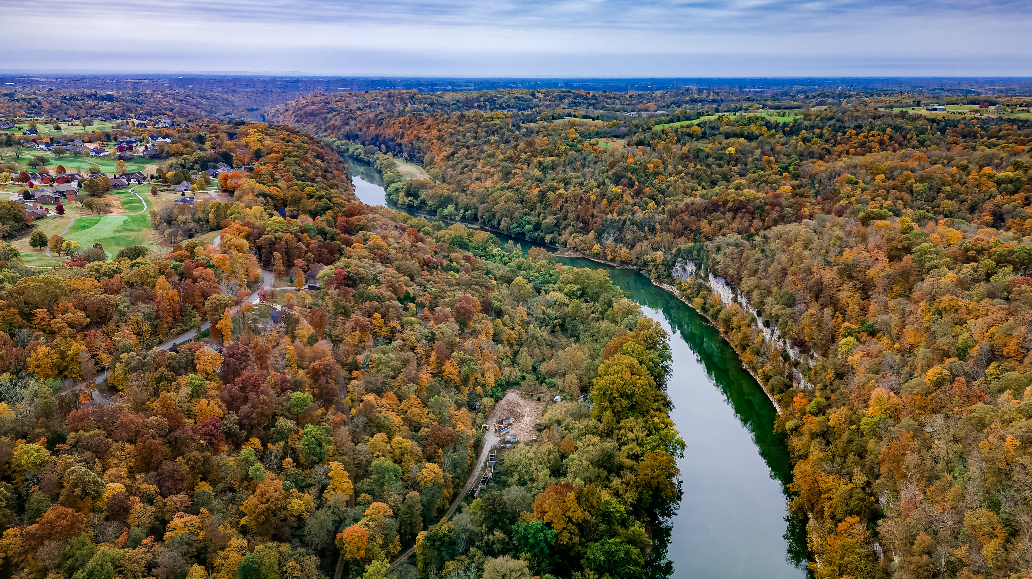
Regional Assessment
Challenges:
​Lack of build ready land for development projects
Housing availability
Lack of skilled labor
High development costs
Relatively unknown to outside audiences
Investment is behind competitor cities
Strengths:
​Access to healthcare
Location and accessibility
Public safety
Public schools & higher education
Cost of living
Quality of life
Notes:
**Note: Two clicks on this slide.
Regional leaders further evaluated challenges and strengths.
Lack of land for projects
Skilled Labor issues
Development costs – planning & zoning challenges
Housing availability
Strengths
- Lots of quality of life assets but we aren’t sharing it with external audiences (telling our story).

Slide 9
Collaboration & Research
150+
9
6
Regional Leaders
Regional Stakeholder Meetings
Leadership Advisory Meetings
2
1,700
3
2
Perception Surveys
Survey Respondents
Focus Groups
Stakeholder Workshops
Notes:
This was a process rooted in a lot of collaboration and research with internal partners in the 9-county region and externally in key markets.
Barnstorming and community meetings in all 9-counties
Young professional focus groups
External market surveys of young professionals

Slide 10
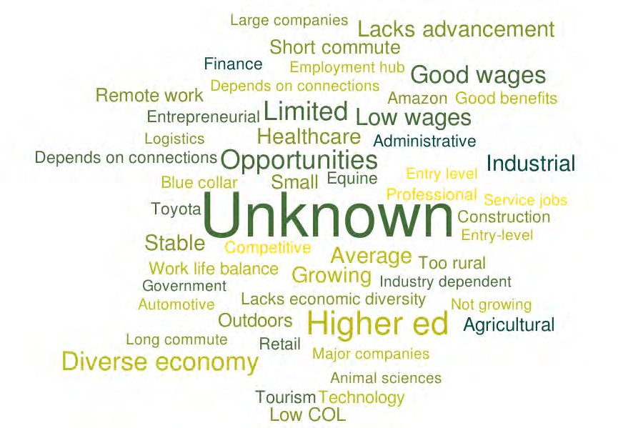

Top Associations with the Region as a Place to Work
Notes:
One of the key research components was the external survey to young professionals in four cities where we were losing talent to.
What we found is that we’re unknown. People don’t know who we are.

Slide 11

Measurable Goals
Increase regional jobs, wages & GDP growth rates to the national average.
Increase the regional labor force including the attraction and retention of young professionals
Attract state and federal funding and advocate for policy improvements to support the plan.
Notes:
After reviewing the data and surveys, regional leaders agreed to a plan with three high-level goals.
Increasing regional jobs, wages and gross domestic product to the national average
Increasing our regional labor force, specifically young professionals in the 25-45 range
Attracting more state and federal investment to the region to support the plan.

Slide 12
Create a regional brand identity
Increase investment in site selector awareness and support multi-jurisdictional product development strategy
Provide economic development education to key leaders
Develop a regional talent recruitment/attraction marketing campaign
Develop strategy to connect businesses with students
Coordinate advocacy for federal and state infrastructure, product development, talent marketing funding
Advocate for improved polices related to key competitiveness issues
7 Action Items
Determined by Regional Leaders
Notes:
To reach those goals, regional leaders agreed to support 7 specific action items.
These action items were selected because they are:
mutually beneficial to all communities (wins for everyone),
There is a greater impact if these actions are done in partnership – rather than alone
We also wanted to work on a handful of items to show success – not create a plan for 20+ items that no one worked on together.

Slide 13

Talent & Workforce Strategy
Create regional talent attraction website
Create new talent social and digital media marketing campaign to alumni/visitors
Develop a strategy to improve business/student connections to enhance retention
Notes:
With talent, we have 4 deliverables for regional leaders. Betsy Dexter on our team is leading these initiatives.
Creating a new regional talent attraction website
Creating a new talent social media and digital marketing campaign to target audiences in key cities
Hosting internal workshops with our regional partners about our talent messaging/marketing strategies for greater alignment.
Developing a strategy to connect businesses with students to increase retention

Slide 14
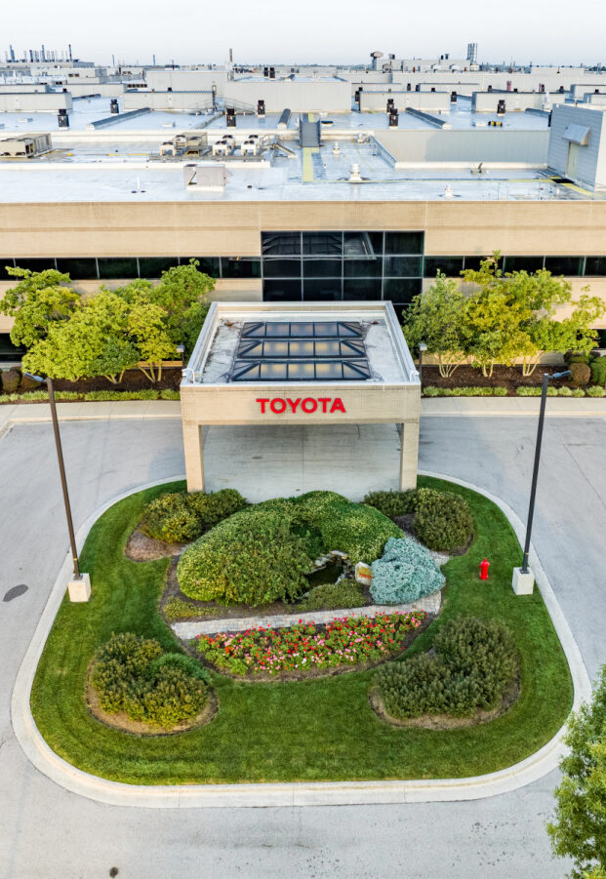
Economic Development
Refresh design of the regional job attraction website
Elevate engagement and marketing of the region with national site selectors
Attend key industry and trade association events
Host economic development leadership and education events
Notes:
Regional economic development leaders are working to execute 4 deliverables.
Refreshing the locateinlexington.com website.
Increasing outreach to site selectors to bring more attention to Lexington and the region (100 engagements)
Attending new events to increase Lexington’s visibility to business targets.
Offering leadership and education events for regional leaders.

Slide 15
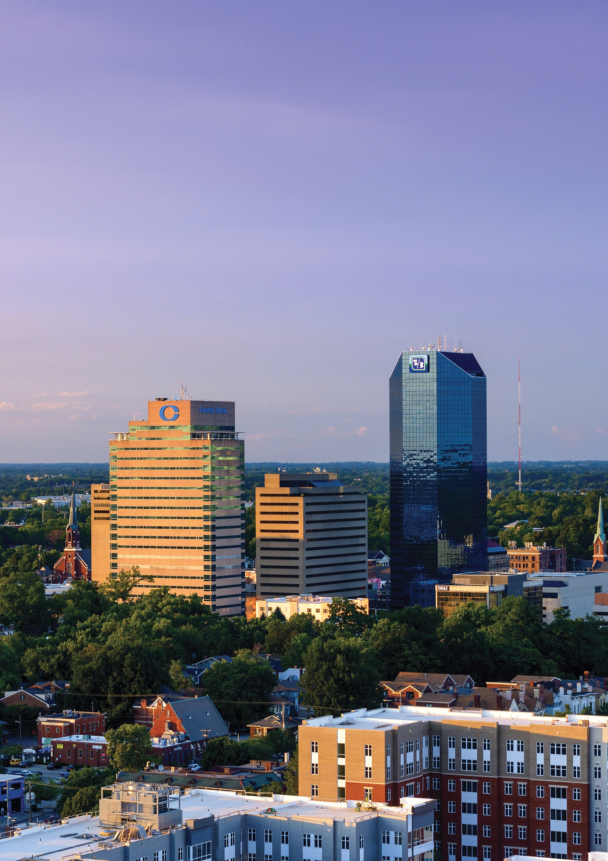
Policy Advocacy
Kentucky Product Development Initiative
Talent attraction marketing funding
Housing affordability policy solutions
Support for key infrastructure projects
Notes:
We are also coordinatin our advocacy as a region and increase investment in infrastructure or other assets that support the action items.
Some of these include:
investments in KDPI
Investments in talent marketing
housing affordability policy solutions like low income housing tax credit programs
And support for UK projects and R&D grant funding

Slide 16
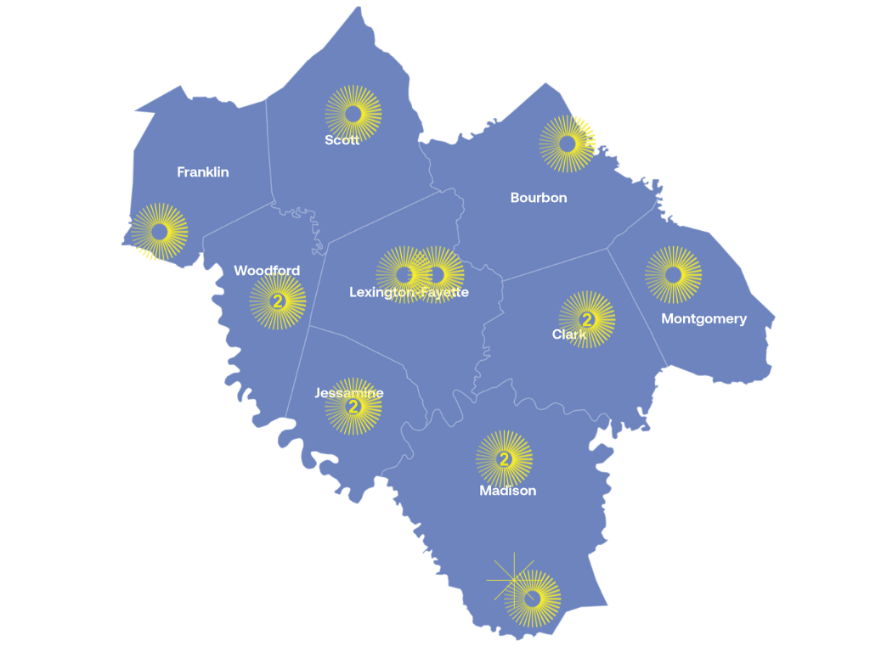

KPDI Approved Project Map
Approved Projects | 15
State Funding | $20.4 Million
Local + State Investments | $66.5 Million
Pending KEDFA Approval | 0
Kentucky Product Development Initiative 2019 - 2024
Notes:
For example, the Kentucky Product Development Initiative program has helped accelerate investments in getting more land/sites ready for jobs in Lexington and the region.
The lack of land and buildings was a challenge for the Lex and region – and for Kentucky.
The General Assembly allocated $100M two years ago. The funds have helped every community in the region. This year, the legislature allocated another $75M.
It has also helped bring local officials together to talk about how do we work together on business parks and share revenues.
The most notable example is the work of Scott, Madison and Fayette are doing to work together on a joint site in Scott County.

Slide 17
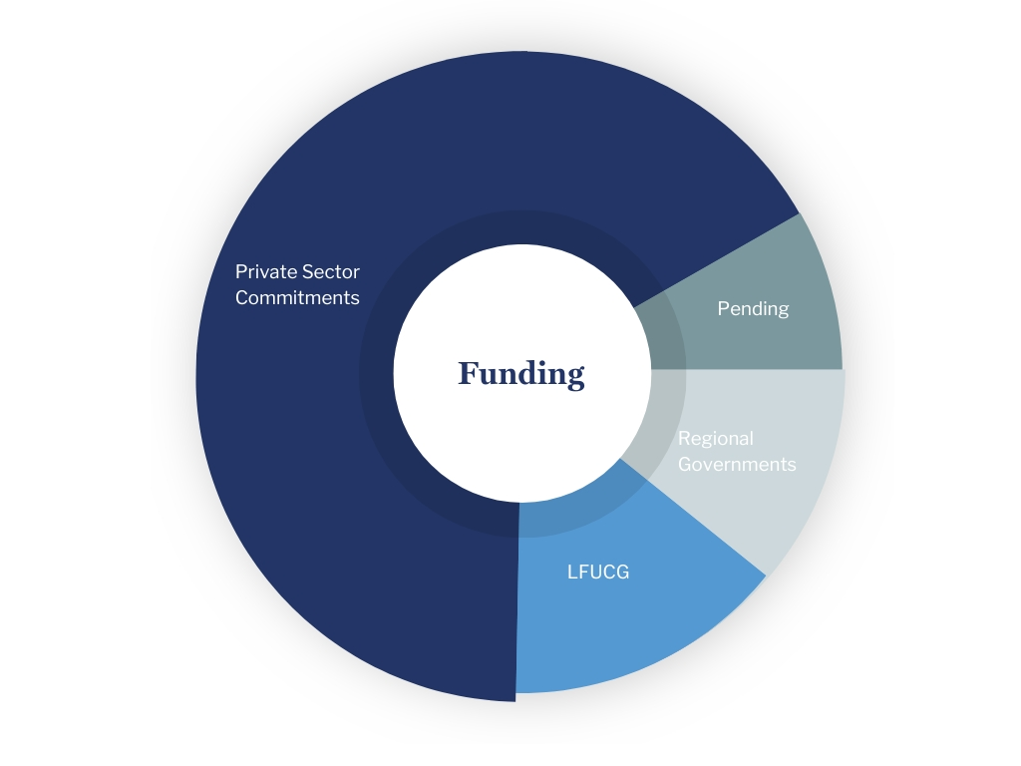
Funding Breakdown
Commitments
Private sector (business) | $1,000,000
City of Lexington | $322,000
Regional Governments | $275,000
Total | $1,597,000​
Pending
Regional Governments | $50,000
Notes:
How are we going to resource the plan?
This is a $1.6M strategy supported by 2 to 1 - business to government.
We’ve raised over $1M in annual investment from business. This is a five-year commitment.
Our regional government partners have invested nearly $600,000 annually. This is based on a $1 per capita model.

Slide 18
Funding Breakdown
Commitments
Regional Governments:
^{City of Lexington}
^{City of Berea}
^{Madison Fiscal Court}
^{City of Richmond}
^{Scott County Fiscal Court}
^{City of Georgetown}
^{City of Versailles}
^{City of Midway}
^{Woodford County Fiscal Court}
^{Bourbon Fiscal Court}
^{City of Nicholasville}
^{City of Frankfort}
^{Jessamine County Fiscal Court}
Franklin County Fiscal Court (pending)
^{City of Winchester (pending)}
Private sector (business) | $1,000,000
City of Lexington | $322,000
Regional Governments | $275,000
Total | $1,597,000​
Pending
Regional Governments | $50,000
Notes:
Note this is the same slide. The side bar changes with the click.
Gina – Note the local government support from the majority of governments in the region in year 1.

Slide 19

We are better together.
Notes:
Gina – Emphasis that we’re better together as a region and we’re better in economic development when we work with UK, City and CLX.

