Slide 1
Commerce Lexington
Economic Development
2025 Advertising & Marketing Campaign
Notes:
Introduction

Slide 2
Economic Development Campaign Overview
Objective
Shift perception of Greater Lexington
Key Focus
Awareness of unique advantages
Target
Businesses to start, stay, and
expand in the region
Notes:
Marketing Objective:
Build awareness
Introduce to new audiences
Educate potential investors
Position as a sophisticated business hub

Slide 3


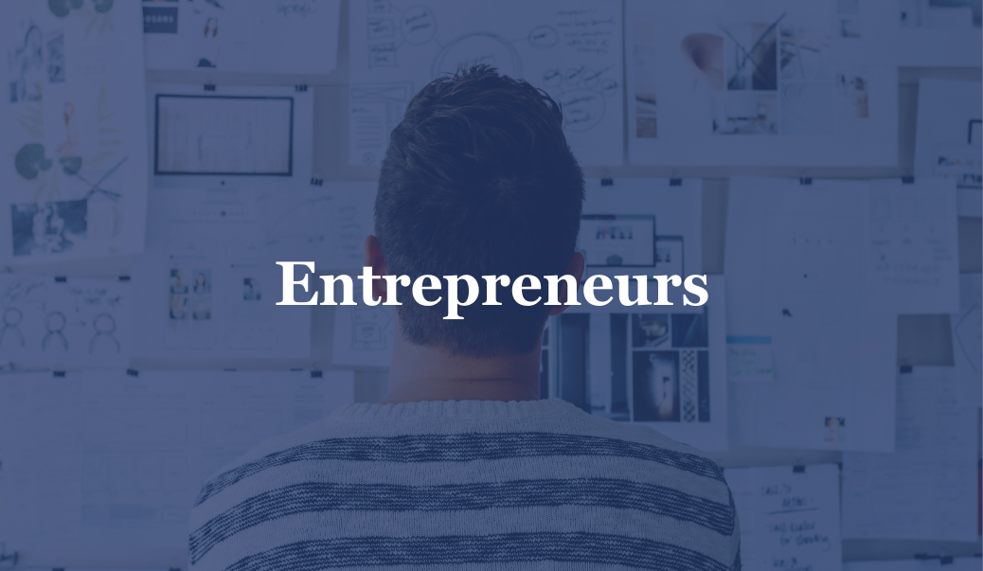
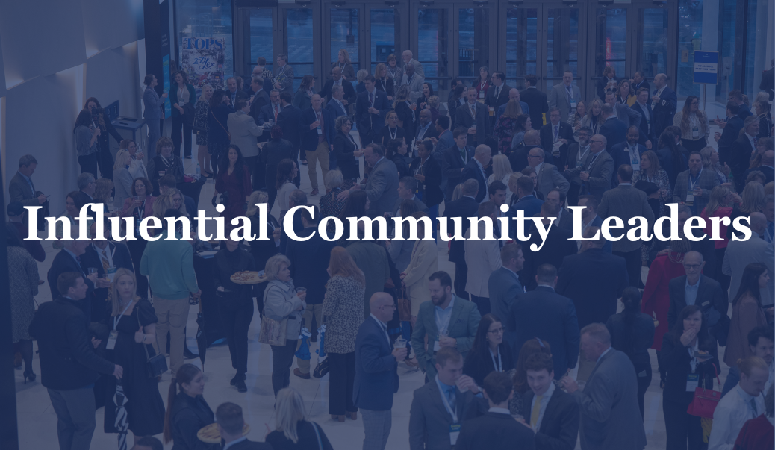

Target Audience
Notes:
PRIMARY: Decision-Makers: C-suite decision-makers, entrepreneurs and site selection consultants in specific sectors (next slide).
SECONDARY: Influential individuals: employees, community leaders, or residents who can bring Greater Lexington to the attention of decision-makers within their own companies.

Slide 4

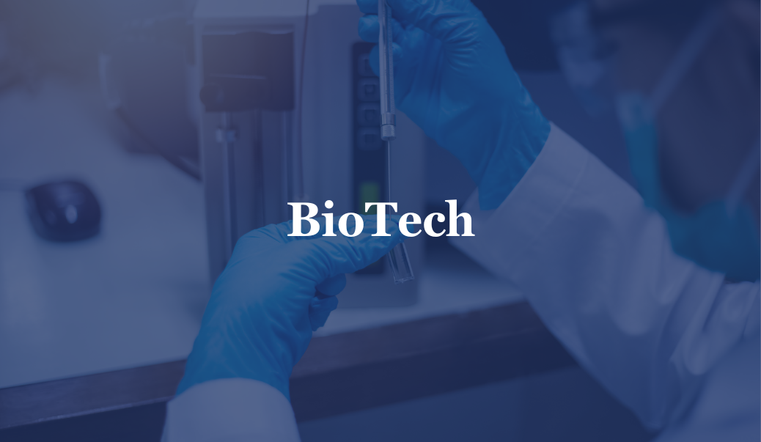





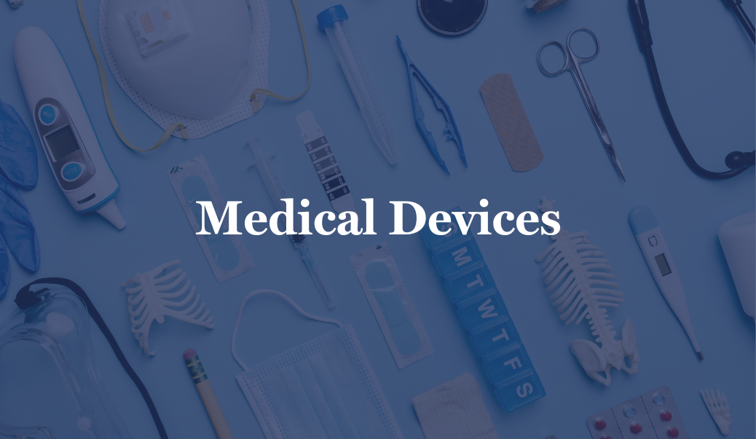
Targeted
Sectors
Notes:
Ted Abernathy study identified these for Lexington and the region….

Slide 5

Campaign Concept
There’s no place greater.
In a clean, sophisticated way, we use a ‘testimonial’ to
target various industries—biotech, advanced manufacturing, food and beverage. For whatever you’re looking for, there’s no place greater.
Notes:
Developing a campaign that strengthens Greater Lexington’s reputation as a business leader by showcasing its competitive advantages and industry growth potential. Our creative needed to address the challenge of increasing Greater Lexington’s visibility and credibility as a prime business destination. We want to ensure that Greater Lexington is seen as a sophisticated, cost-effective, and strategic location for companies to relocate, expand, or start. Additionally, we have to overcome outdated perceptions of our geographical region, and introduce Greater Lexington as a business-friendly region capable of supporting advanced industries. The messaging reinforces the fact that companies can locate, relocate and expand in Greater Lexington without compromising quality or opportunity.

Slide 6

Campaign Design
Notes:
The creative uses proven success stories from global companies, innovative start ups and other companies which have thrived in Greater Lexington. It is simple, but eye-catching. It is unique in the ocean of Economic Development advertising that have the same basic elements that don’t make places stand out.

Slide 7
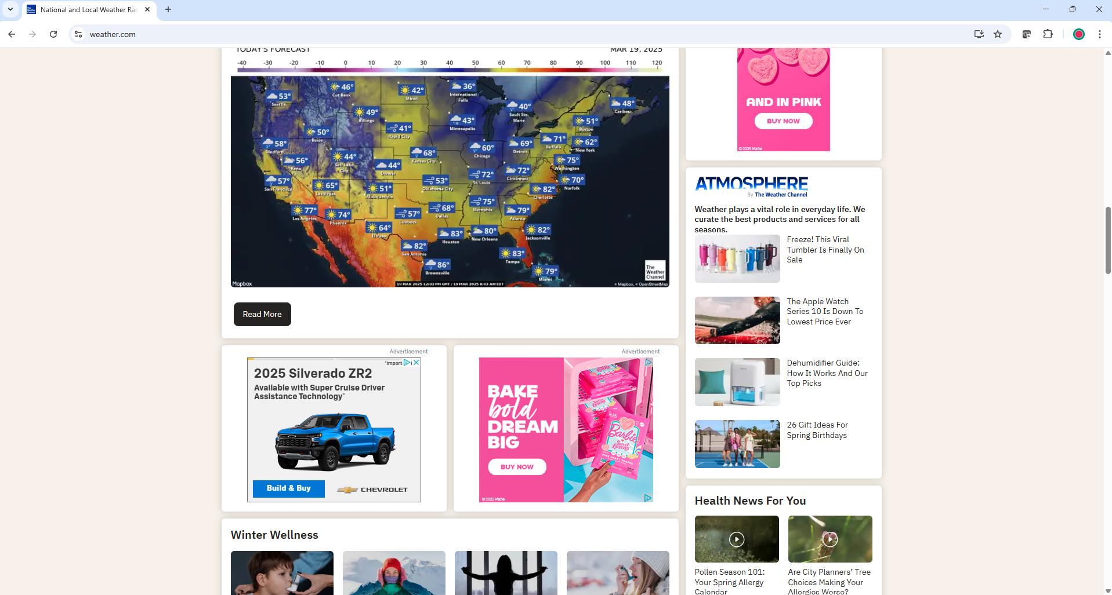

Campaign Design
Notes:
This is an example of a banner ads that have a wide reach across website – the content that the target audience is consuming when scrolling on
Our audience is based off NAICS code targets to c-suite execs and site selectors within those industries – the ad network using data to target these groups.
To make this process easier, our marketing agency, BORN, uses ad networks. These networks connect us with publishers and help distribute ads across a wide range of websites. They are like the middlemen who manage the logistics of ad placements.
After the ad is displayed, the advertiser can track how many people saw it or clicked on it, which we will then report out quarterly, like the Talent campaign.

Slide 8
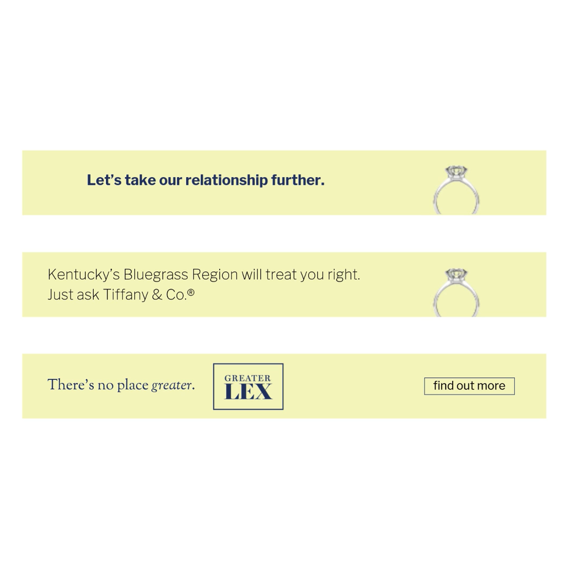
Campaign Design
Notes:
More examples of digital advertising, using the Tiffany feature.

Slide 9
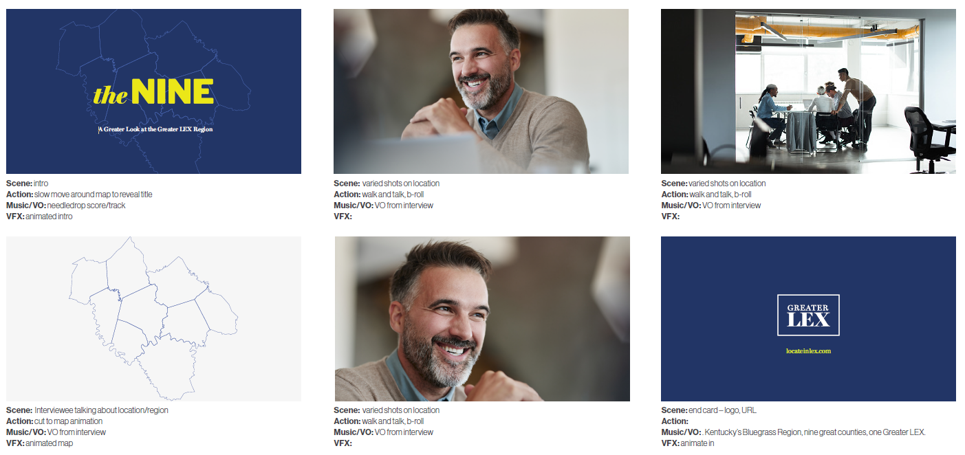
Video Vignettes
The NINE: A Greater Look at Greater LEX.
Notes:
A video vignette series designed to promote the region through the experiences and insights of Greater LEX Leaders who represent existing businesses within the strategic targets.
60 seconds or less, branded intro and outro, candid convos with key industry leaders
Unifies the region under a single brand while offering flexibility through subtitles for specific industries, opportunities, and audiences.
Location: Facilities that highlight innovation, ingenuity and sophistication. Locations that highlight regional features/culture (live or work).
Primary Use: social, website, presentations, targeted digital opportunities

Slide 10

Notes:
This is a draft of a vignette – the donut (book ends of a video). The middle will be the content we film based on our targeted industries. We start filming at the end of this month, with the first feature being on Bio.

Slide 11
Media Plan
Digital Display: 300x250, 728x90,300x600,320x50
  Demo Target: Founder, Owner/Principal, Partner, Advisor, Board of Directors, C-Suite Executives
  Industries: Selected NAICS Codes
  Monthly Impressions: 100,000 (1 million total)
Digital Video: < :60 spots
  Demo Target: Founder, Owner/Principal, Partner, Advisor, Board of Directors, C-Suite Executives
  Industries: Selected NAICS Codes
  Monthly Impressions: 65,000 (585,000 total)
LinkedIn: Paid Posts
  C-Suite Executives
  Industries: Food and Beverage Services,
  Biotechnology Research, Manufacturing,
  Financial Services, Business Consulting and Services
  Monthly Impressions: 60,000 (600,000 total)
Notes:
The primary goal for our media plan is to ensure that Greater LEX is heard, seen, and strongly considered by the decision makers who could potentially select our region as a prime business location. We have built a plan that captures our two main strategic audiences:
• site selectors for your target sectors and markets
• c-suite execs looking to start a new business, or expand into new or existing locations

Slide 12
Media Plan
Event Geofencing: < :60 spots & Digital Displays
  Demo Target: Users that attend selected events
  Events:
    American South Site Selection Summit
      Impressions: 6,000
    SelectUSA
      Impressions: 6,000
    State Farm Championship Classic
      Impressions: 2,000
Notes:
Geofencing is like creating a virtual boundary around a specific location using GPS or Wi-Fi. We’ve selected a handful of shows to target, in which the attendees information will be gathered, to then serve ads after the show is over.
Some events we will also be attending, but we can use this type of advertising for events we do not have the budget to send someone…

Slide 13
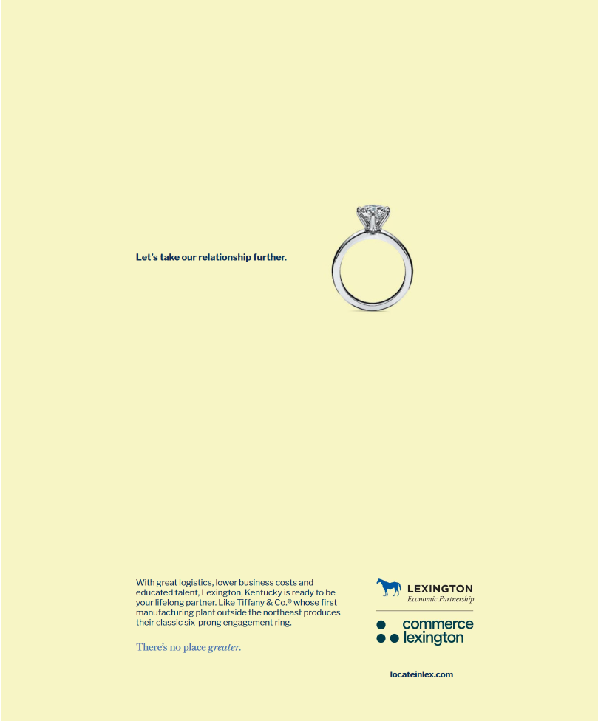
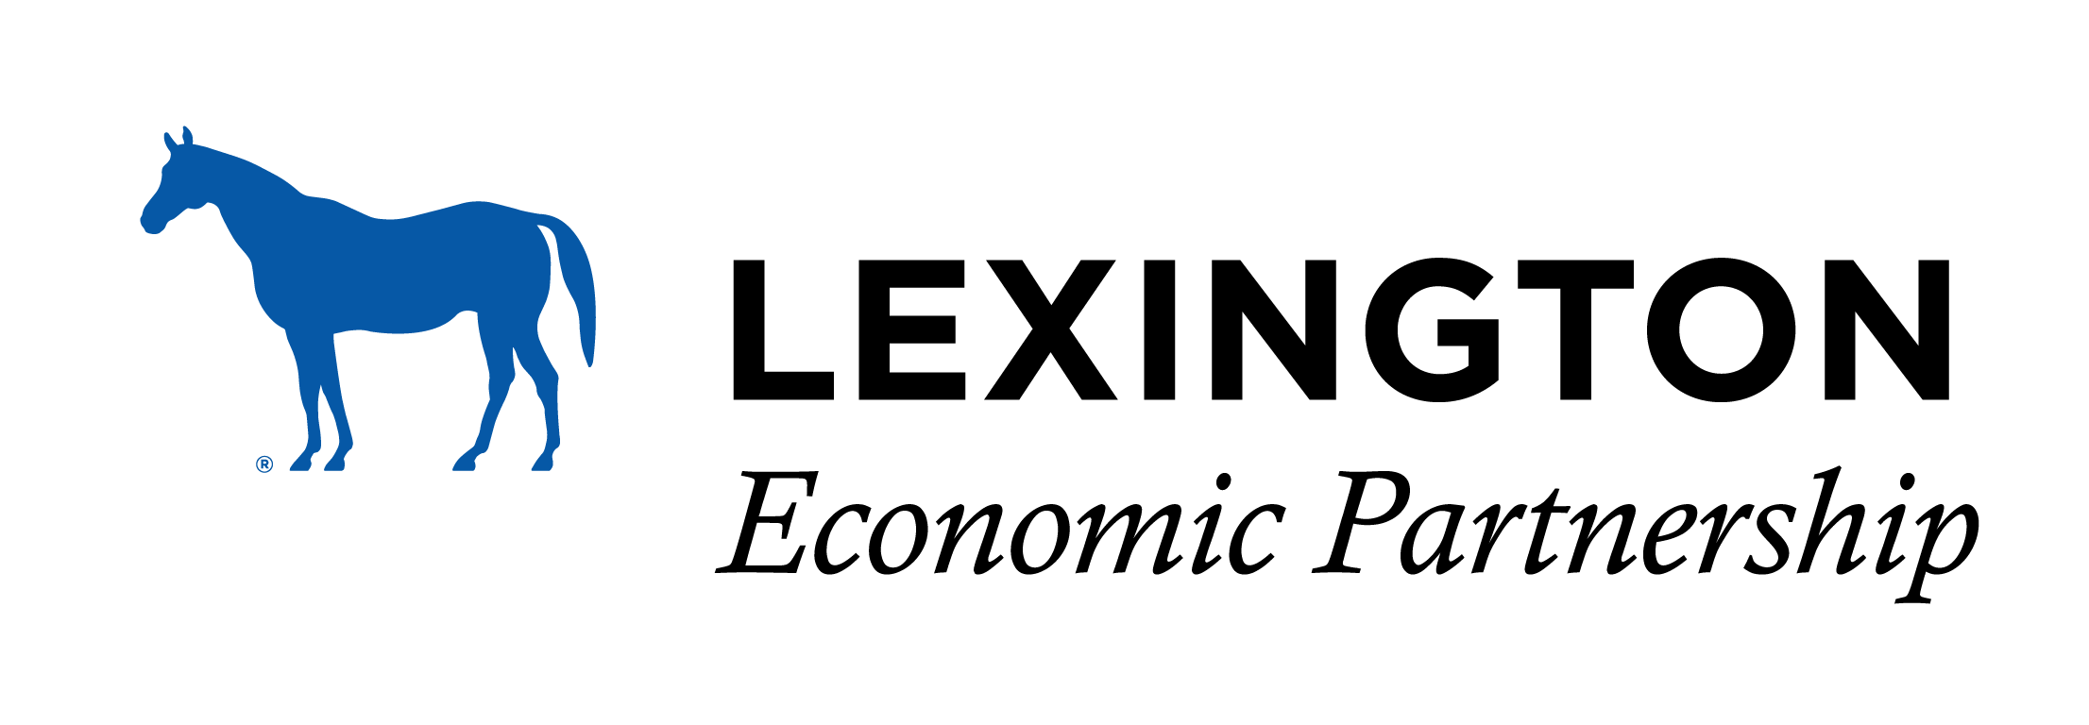
Media Plan
Lexington Economic Partnership
Event Geofencing: :30-:60 spots & Digital Display
  Demo Target: Users that attend selected events
  Events:
    Drug, Chemical & Associated Technologies
      Impressions: 16,000
    Keeneland (Spring & Fall)
      Impressions: 174,000
    Defender Kentucky 3-Day
      Impressions: 24,000
    BIO International
      Impressions: 12,000
Notes:
Smaller budget, using same theme with Lexington specific language.
Last week our first geofencing took place at DCAT – attendees of that conference will start to be served our ads, and in the coming months we will have those numbers
We target Keeneland and the 3-day event because these are warmer audiences with a lot of money and potential to invest in Lexington.

Slide 14

Notes:
We are driving the targeted audience to our website where the data and empirical evidence is. Site selectors do most of their fact finding before ever reaching out to us. We want them to see we are bigger than the 6-county metro. That we are an emerging bio-tech hub, etc….
The ED site hype reel shows the new layout and tools on the website that we are driving traffic to from the campaign.

Slide 15
THANK YOU!

